Slide 1
Adventure Works Manufacturing & Sales
An Insight-Driven End-to-End Performance Analysis across Excel, SQL, Power BI, and Tableau.
Project Lead & Analytics Presentation

Slide 2

Excel: Exploratory Audit & Category Concentration
Initial Discovery & Scope
Key Baseline Findings
Through initial pivot tables and baseline summaries, we audited raw multi-year transactional logs ($29.36M total revenue across 60,398 order lines) across regional portfolios.
1. Seasonal Distribution: Q4 delivered the strongest quarter at 31% of annual revenue, versus just 19% in Q1.
2. Category Concentration: Bikes generated 96.5% of total revenue from only 25% of order lines — Accessories drove 60% of volume but just 2.4% of revenue.
Data profiling immediately highlighted seasonal swings and a heavy revenue dependency on a single product category.

Slide 3

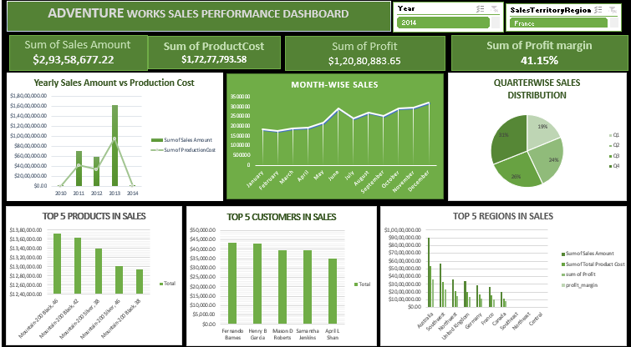
Excel: Regional Margin Signals & Cost Structure
Margin Erosion: Your two highest-revenue regions, Australia and Southwest, post the lowest net margins in the portfolio (40.7% and 41.5%) versus 43–45% in the smallest markets.
Cost Structure Check: Freight sits at a flat 2.5% of sales in every region, ruling out shipping as the cause — the margin gap traces back to product mix instead.
Analytical Bridge: These preliminary variances exposed the limits of spreadsheet modeling and set the stage for deeper relational SQL auditing.

Slide 4


Excel: Synthesis & Transition to SQL
The Excel Analytical Takeaway
Our preliminary Excel phase proved that headline revenue figures mask real concentration risk: one category and a handful of SKUs drive almost all profit, while freight costs stay flat regardless of region. Pivot tables could show where these patterns sit, but not why they persist across millions of transaction-level rows.
Strategic Transition: Consolidate two raw fact tables and engineer a clean, query-ready dataset in SQL to support deeper, repeatable analysis.

Slide 5
SQL: Data Consolidation & Fiscal Calendar Engineering
Schema Consolidation & Enrichment
Building a Fiscal Calendar
We combined two raw fact tables, FactInternetSales and Fact_Internet_Sales_New, into a single Fact_Sales_Combined table using UNION ALL.
1. Date Engineering: Derived Year, Month, Quarter, Weekday, and a full financial calendar (Financial Month & Quarter) directly from the raw OrderDateKey field.
The combined table was then enriched with product and customer names through left joins to the product and customer dimension tables.
2. Query Validation: Every derived field was checked against a 10-row sample before being applied across the full combined table.

Slide 6
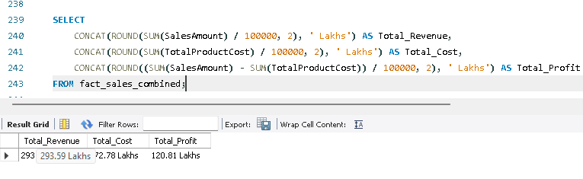
SQL: Revenue Engineering & Profitability Modeling
Revenue Recalculation: Rebuilt Calculated_Sales_Amount from OrderQuantity × UnitPrice net of discounts, and validated it against the original SalesAmount field.
COGS Modeling: Engineered a permanent ProductionCost column (ProductStandardCost × OrderQuantity) to model true cost of goods sold at the line-item level.
Clean Data Foundation: Structured, validated relational data was now ready for interactive business intelligence modeling.

Slide 7
SQL: Core Insight & Modeling Readiness
The SQL Analytical Takeaway
SQL work turned two inconsistent raw fact tables into one clean, validated dataset, complete with a fiscal calendar and engineered revenue and cost columns confirming a total portfolio profit margin of 41.1%. With this foundation in place, we moved to Power BI to make these numbers explorable in real time.
Strategic Transition: Build an interactive Power BI dashboard so managers can slice revenue, cost, and profit by year, quarter, product, and region without writing SQL.

Slide 8
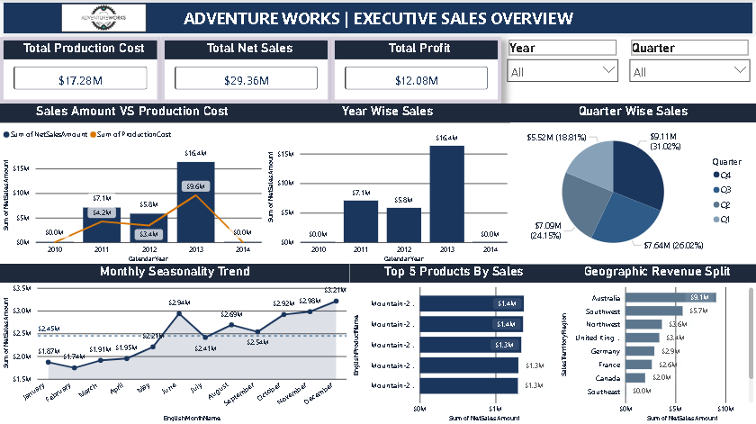
Power BI: Executive Dashboard & KPI Monitoring
Real-Time Tracking Canvas: Built an interactive executive dashboard with Total Sales, Total Production Cost, and Total Profit KPI cards, filterable by year and quarter.
Seasonality & Trend View: A monthly seasonality trend line and a year-over-year sales-vs-cost combo chart made revenue swings visible at a glance.
Ranking Views: Top 5 Products and Geographic Revenue Split bar charts surfaced the biggest products and regions by net sales instantly.

Slide 9
Power BI: Core Operational Takeaways
Eliminating Reporting Latency
Ranking Visibility
The dashboard replaced static pivot tables with live, slicer-driven views — year and quarter filters let managers reslice revenue, cost, and profit instantly instead of rebuilding pivots by hand.
Dedicated Performance by Customer, Product, and Region pages let managers instantly identify top and bottom performers across all three dimensions.

Slide 10
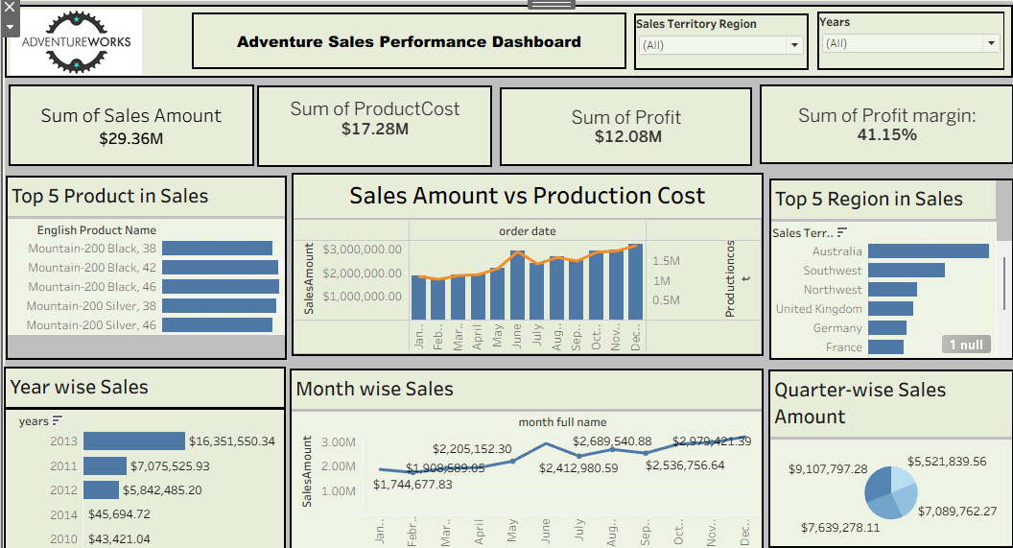
Tableau: Executive Sales Performance Dashboard
Unified Executive View: Brought Top 5 Products, Top 5 Regions, and Year/Month/Quarter-wise sales into a single Sales Performance Dashboard for board-level review.
Cost-to-Profit Visualization: A Sales Amount vs. Production Cost view let leadership see margin pressure alongside revenue growth in one frame.
Executive Storytelling: Delivered a clean, filterable visual narrative packaging the same core KPIs as Excel and Power BI for non-technical stakeholders.

Slide 11
Tableau: Product & Regional Performance Deep-Dive
Top Product Concentration
Regional Performance Ranking
The Top 5 Products view showed just 5 Mountain-200 SKUs generating $6.67M in revenue — nearly a quarter of the total — reinforcing the concentration risk flagged in the Excel phase.
The Region Sales Performance view let leadership compare revenue, cost, and margin side-by-side across all ten territories in one filterable canvas.

Slide 12
Conclusion & Strategic Roadmap
Integrated Stack Synthesis
Strategic Recommendations
1. End-to-End Value: Combining Excel exploration, SQL data engineering, Power BI monitoring, and Tableau storytelling delivered one consistent, validated view of revenue, cost, and profit.
1. Category Rebalancing: With Bikes at 96.5% of revenue from only 25% of order lines, examine whether Accessories and Clothing are under-priced or under-marketed relative to their order volume.
2. Consistent Numbers Throughout: The same revenue, cost, and profit figures, validated in SQL, hold across every downstream tool — proving the pipeline, not just the dashboards.
2. Regional Margin Review: Audit product mix in Australia and Southwest, the highest-revenue, lowest-margin regions, since freight costs alone don't explain the gap.

Slide 13


